Slide 1
Filter
Filter

Slide 2
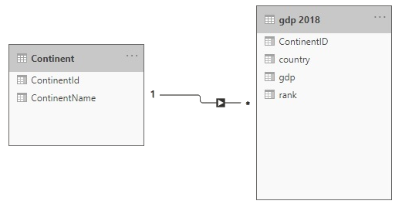
Filter
Note: This workshop uses the gdp.xlsx file located in the resources \ Drillthrough and Filter folder .
Navigate to the location of the gdp.xlsx file and load both tables continent
and GDP 2018 in the query editor.
Check the relationship between continent and gdp 2018 East GOOD established .

Slide 3

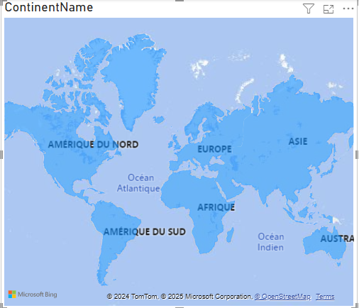
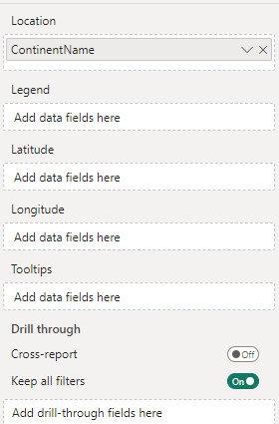
Filter
Label the two pages of the report:
GDP
Continent Details
Add three visuals to the GDP page level , a geographic map visual, a histogram visual, and a label visual
Add a visual Filled Map with ContinentName in the Location field

Slide 4
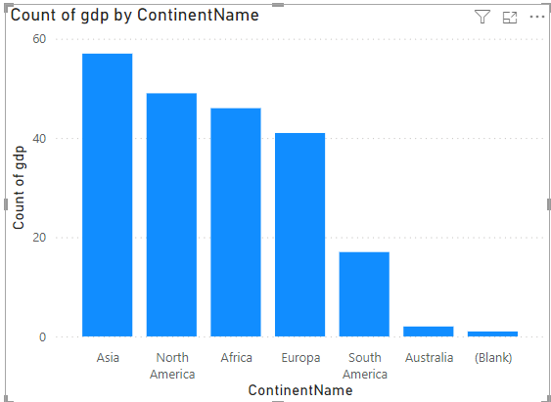
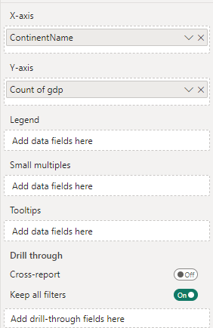
Filter
Add a visual Histogram to the Details page and slide ContinentName to the X axis and Count of gdp to the Y axis

Slide 5
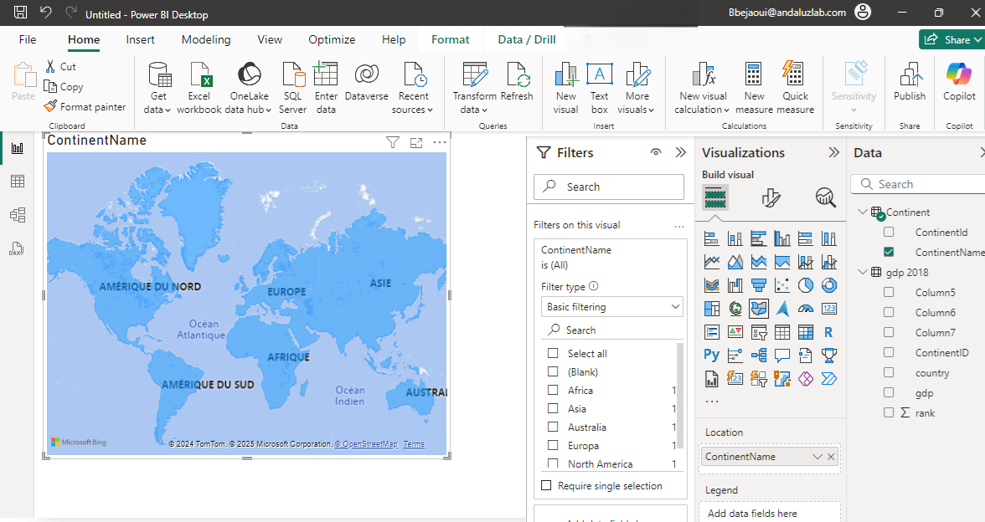
Filter
Name the two pages GDP and Continent Details respectively
Add a Filled Map Visual and drag ContinentName at the level Rental

Slide 6
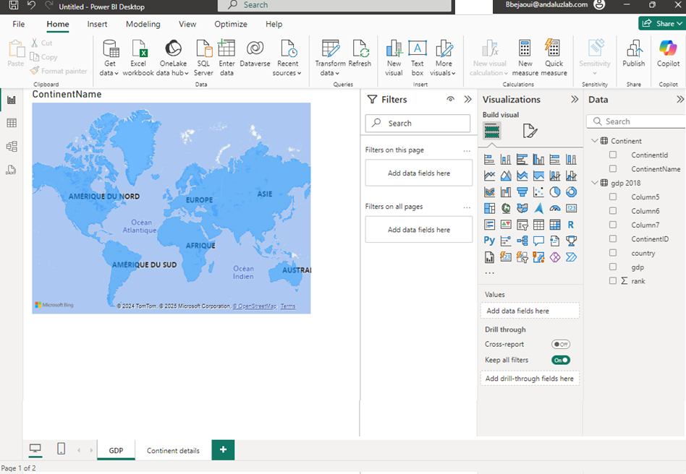
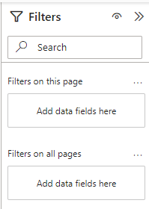
Filter
Note that when no visual is selected, the filter pane displays two filter levels:
The current page level
The level of all pages
1
2

Slide 7
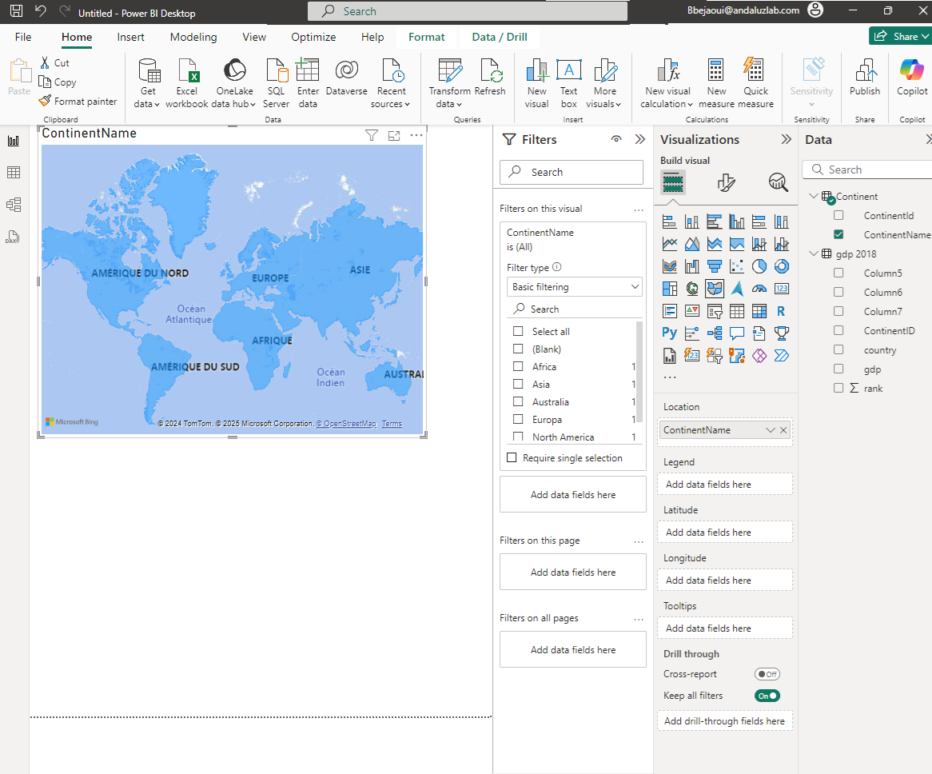
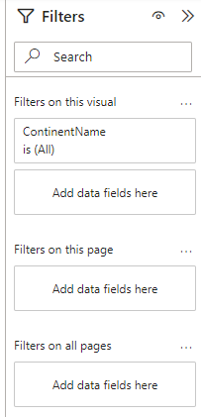
Filter
Note when a Visual is selected a third level of filtering appears
1
2
3

Slide 8
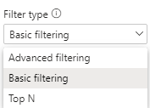
Filter
Try applying the filter based on ContinentName for each of the levels separately: the visual, then the current page, then all pages.
Notice the change in the interface and also note that the filter type is basic. Expand the filter type drop-down list.

Slide 9
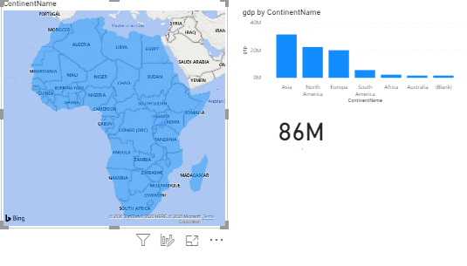
Filter
Keep the alternative Basic
Select Africa and observe the change in the map view.

Slide 10
Filter
Compare with the visual next to it , notice that the filter is applied only for
the case of the visual located on the left.

Slide 11
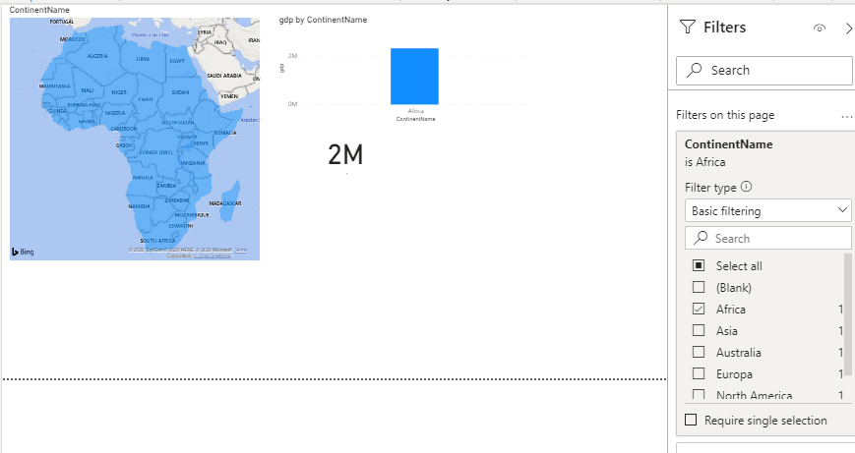
Filter
Apply the filter at the page level instead of the map visual and observe the change
of behavior of the three visuals .

Slide 12
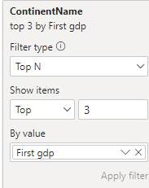
Filter
Navigate to the details page and notice that the filter is not applied at this different page level.
Go back to the GDP page and apply the filter based on ContinentName to all pages, then notice that the filter is now applied to all pages in the report without exception.
Top N filter type .
Configure the filter as shown in the figure.
1
2
3
4

Slide 13
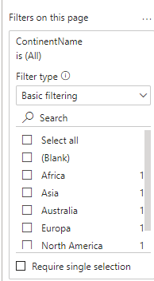
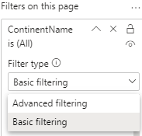
Filter
Go back to the page level filter and notice that Top N is no longer a filter type option.
Note that filter types no longer include Top N , even at the All Pages level , and it is only applicable at the Visual level .

Slide 14
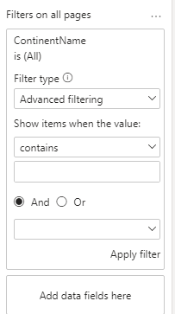
Filter
Note that by switching to the Advanced type , we will obtain a finer granularity in terms
data filtering .​​
1
2
3
4

Slide 15
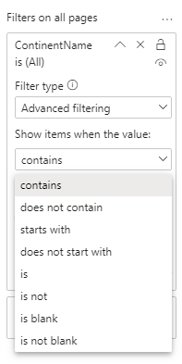
Filter
Note that the application of the advanced filter is assisted by a defined number of filtration criteria.

Slide 16
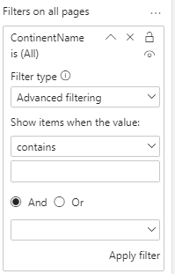
Filter
Note that it is applicable to at most two selections per filter in advanced mode.

Slide 17
Thank you
Thank you

